Slide 1
Particle physics event classification
By Sangamesh S Bankapurmath

Slide 2

In the intricate dance of subatomic particles, event classification unveils the hidden choreography of the universe. -Anonymous

Slide 3
Table of Contents
2. Problem Statement and Objective
3. Approach and Content
4. Model Selection
5. Conclusion
1. Particle Physics History

Slide 4
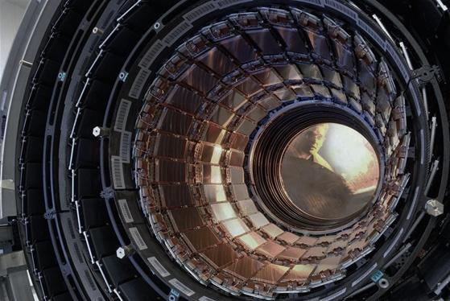
Particle Physics History
The Large Hadron Collider (LHC) at CERN accelerates protons to near-light speed, colliding them to study subatomic particles. Experiments like ATLAS and CMS analyze these particles, yielding insights into fundamental aspects of the universe, including the discovery of the Higgs boson in 2012. LHC's research enhances our understanding of matter, energy, and the fundamental forces shaping the cosmos.

Slide 5
Problem Statement and Objective
Problem Statement:
In the field of particle physics, accurate identification and classification of events are crucial for understanding fundamental particles and their interactions.
The provided dataset contains various features derived from particle physics experiments, and the goal is to build a machine-learning model to classify events into signal (s) and background (b) categories. This classification aids in distinguishing events of interest (signal) from background noise
Objective:
The primary goal of this machine learning project is to develop a model that can accurately predict whether a given set of experimental features corresponds to a signal or background event.
Successful classification contributes to the advancement of particle physics research by automating the identification of events that may indicate the presence of specific particles or phenomena.

Slide 6
Approach and Content
EDA
Data Duplicates
Null Value Treatment
Feature Analysis
Correlation Matrix (Heat Map)
Univariate Analysis
Distribution Plots
Box Plots
Train Test Split
Training Data (80%)
Testing Data (20%)
Scaling the feature
Robust Scalar
Model Building
Logistic Regression
Random Forest Classifier
Evaluation
Accuracy Score
Confusion Matrix
Classification Report
Cross validation with F1 score
Model Selection
Computational expense
Interpretability
Scalability
Conclusion
Inference
Recommendation

Slide 7
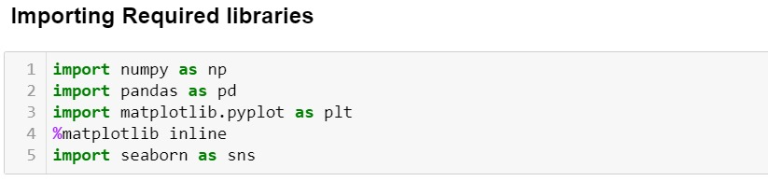
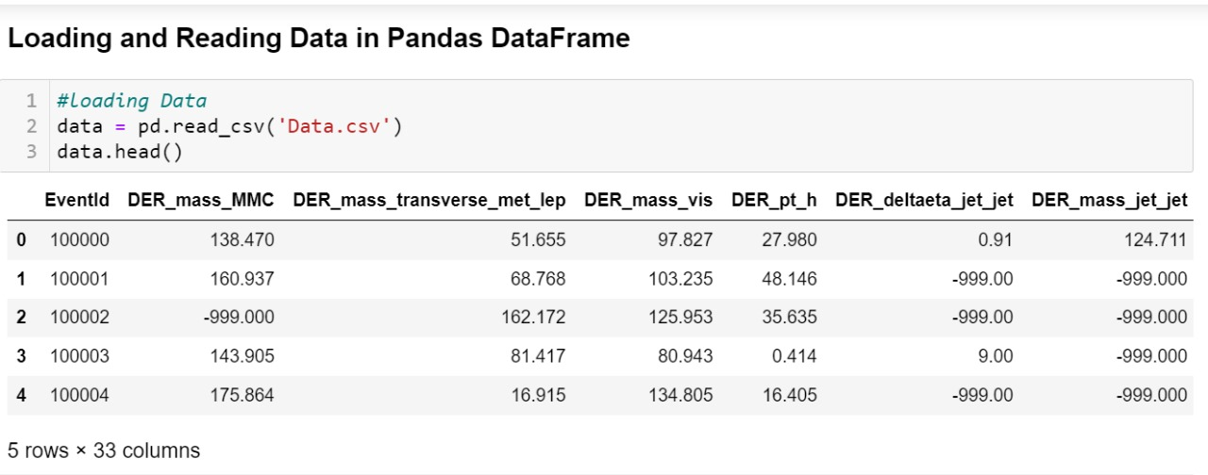
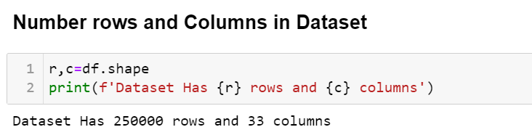
Data Loading

Slide 8
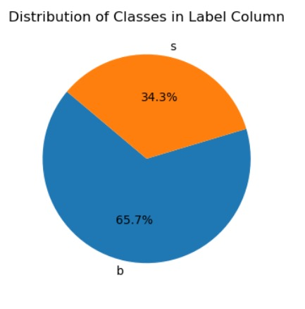
Exploratory Data Analysis(EDA)
Analyzing Target feature:
The dataset Has 65.7% of 'b' Class and 34.3% of 's' Class we can say that a dataset is Moderately imbalanced

Slide 9
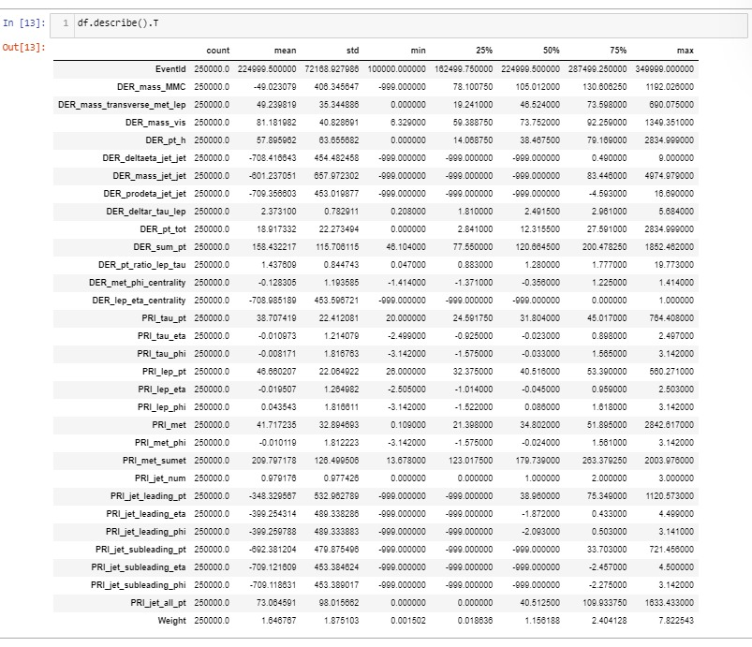
Statistical Summary

Slide 10
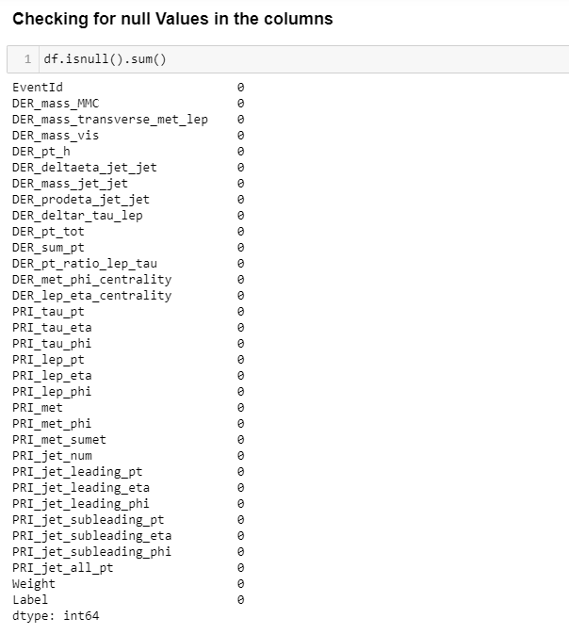
Null Value Treatment

Slide 11
Null Value Treatment
Undefined or Missing Data: -999 could be used to represent undefined or missing data in certain measurements or variables. This is common in experimental data where certain readings or measurements may not be available.
Error Code: It might serve as an error code, indicating that there was an issue or anomaly in the data collection process.
Detector or Instrument Malfunction: -999 might be assigned when there's a malfunction in the particle detector or experimental instrument. It could be a way to mark data points that are affected by technical issues.

Slide 12
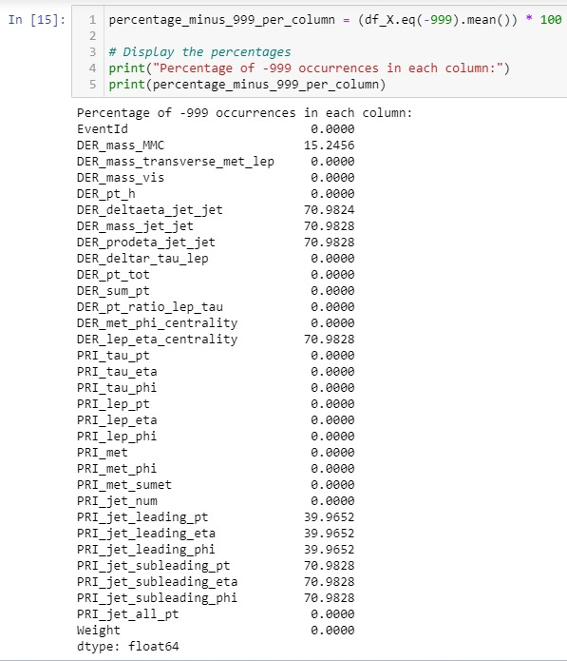
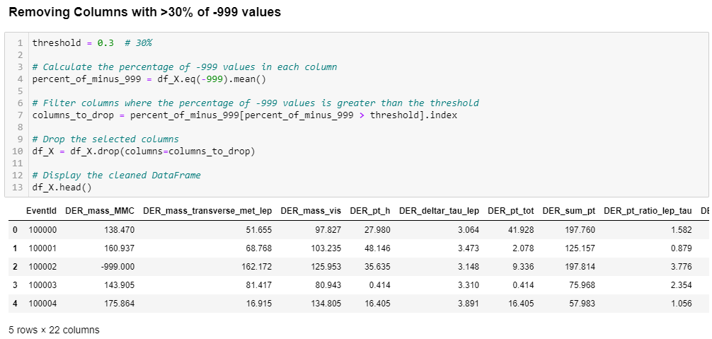
Null Value Treatment
Removing The Columns with >30% of -999 Values

Slide 13
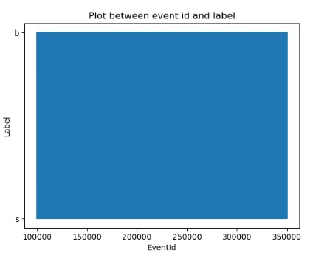
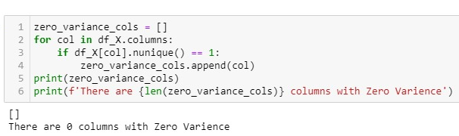
Feature Analysis
This Represents that there is no correlation between 'EventId' and 'Label' we can drop that column
Checking for Zero Variance columns:
There are no zero variance columns

Slide 14
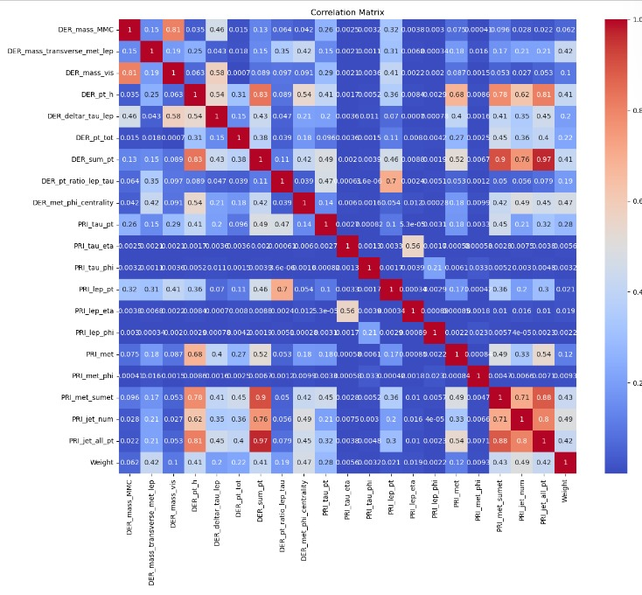
Correlation Matrix (Heat Map)
Remove features with High Correlation(>0.8) that might introduce multicollinearity.

Slide 15
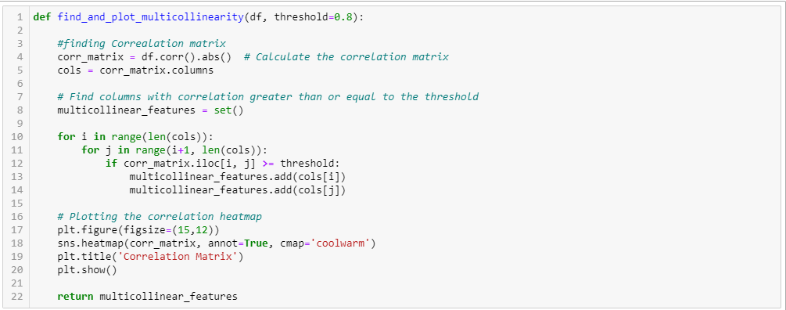
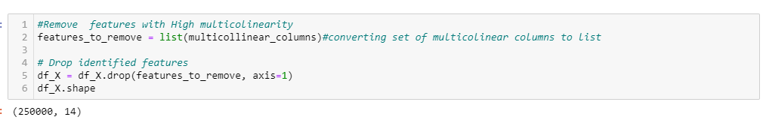
Removing The Columns with High correlation
Correlation among the input Features introduces the multicollinearity which would reduce the model’s stability, and redundant information that can lead to overfitting

Slide 16
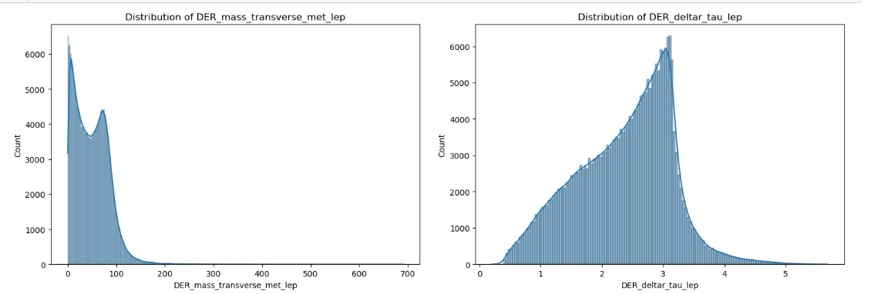
Univariate Analysis
The data points are concentrated on the left side of the graph, which suggests that there are more net loops with lower values of DER mass transverse met lep. This is a right-skewed distribution.
The data points are concentrated on the Left side of the graph, which suggests that there are more net loops with higher values of DER deltar tau lep. This is a Right-skewed distribution.

Slide 17
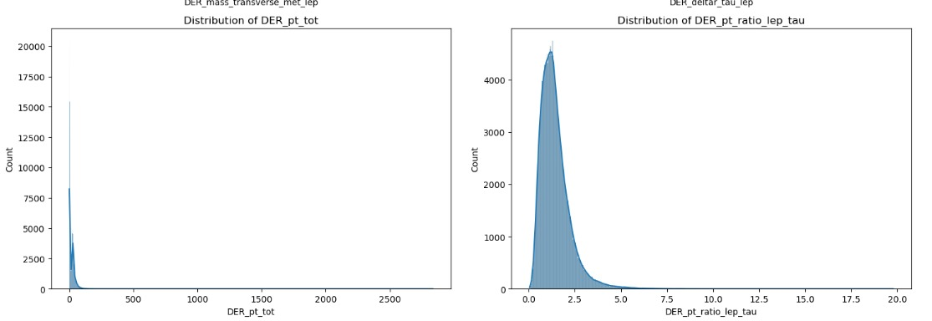
Univariate Analysis
The data points are concentrated on the left side of the graph, which suggests that there are more events with lower values of DER pt tot. This is a right-skewed distribution.
The data points are concentrated in the middle of the graph, with a slight skew to the right. This suggests that there are more events with values of DER pt ratio lep tau around 5, but there are also a significant number of events with lower and higher values.

Slide 18
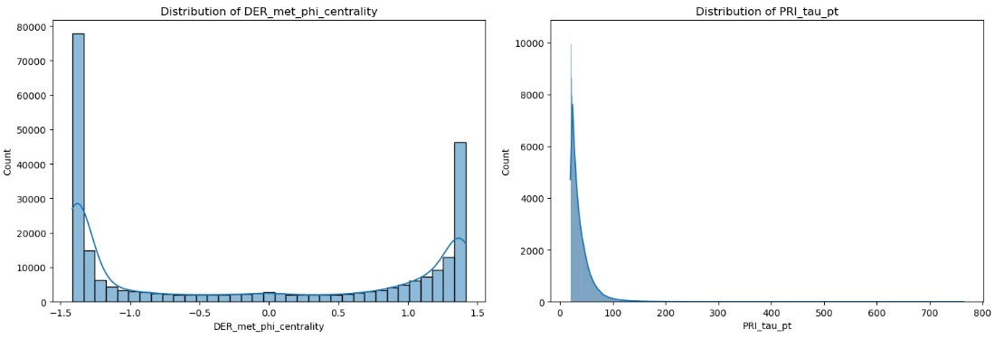
Univariate Analysis
The data points are concentrated in the middle of the graph, and taper off towards both ends. This suggests that there are more events with a middle range of DER concentration and fewer events with very low or very high DER concentration. This is a symmetrical distribution, also Near a normal distribution.
The data points are concentrated on the left side of the graph, with a tail trailing off to the right. This suggests that there are more events with lower values of DER concentration and fewer events with higher values. This is a right-skewed distribution.

Slide 19
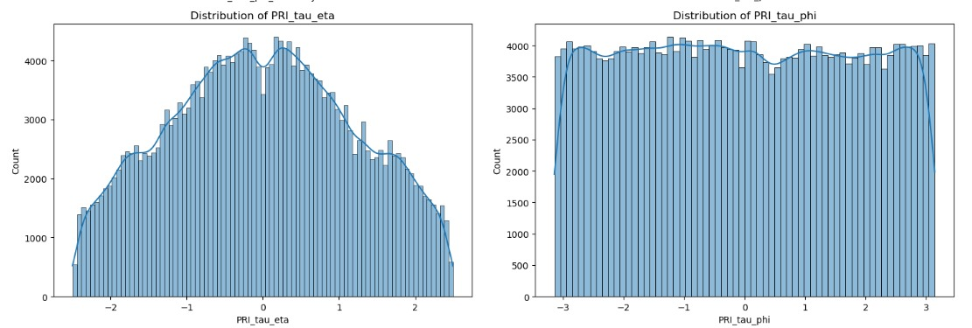
Univariate Analysis
The data points are concentrated in the left middle of the graph, with a tail trailing off to the right. This suggests that there are more PRI events with lower values of "PRI tau eta", and fewer events with higher values. This is a relatively symmetrical distribution.
This suggests that there are a similar number of PRI events with lower, middle, and higher values of "PRI tau phi". This is a relatively symmetrical distribution.

Slide 20
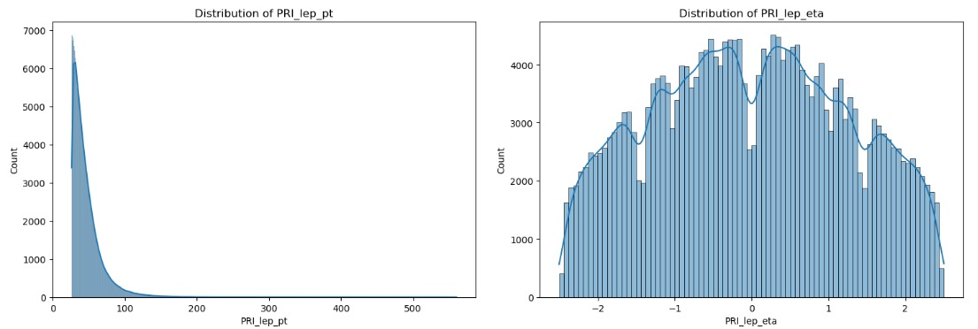
Univariate Analysis
The data points are concentrated on the left side of the graph, with a tail trailing off to the right. This suggests that there are more particles or events with lower values of PRI_lep_pt, and fewer events with higher values. This is a right-skewed distribution.
The data points are concentrated on the left side of the graph, with a tail trailing off to the right. This suggests that there are more PRI events with lower values of "PRI lep eta", and fewer events with higher values. This is a relatively symmetrical distribution.

Slide 21
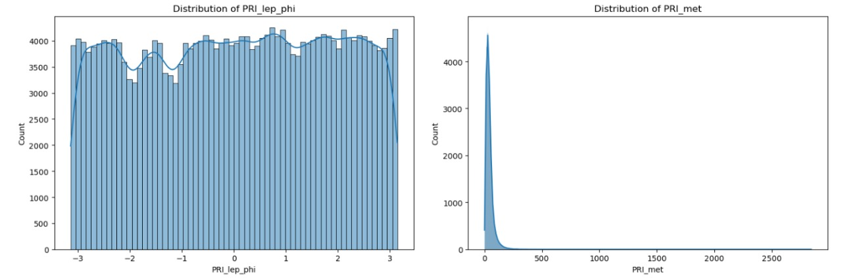
Univariate Analysis
The distribution appears to be relatively uniform across the range of phi values. This is a relatively symmetrical distribution.
The distribution peaks around zero, and then falls off on right side. This is a slightly right-skewed distribution.

Slide 22
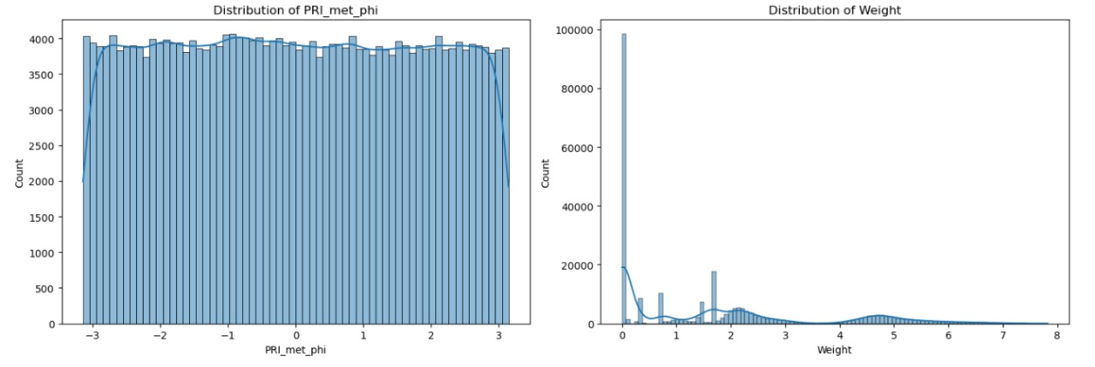
Univariate Analysis
The distribution appears to be relatively uniform across the range of phi values. This is a relatively symmetrical distribution.
The distribution is skewed to the Right. This means there are more data points clustered towards the left side (lower weight values) with a longer tail extending towards the right side (higher weight values).

Slide 23
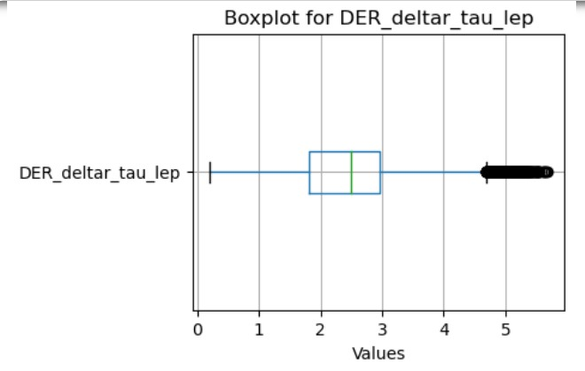
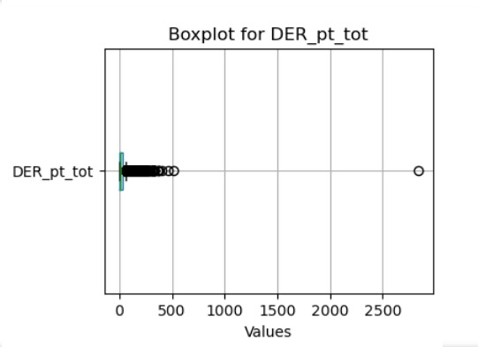
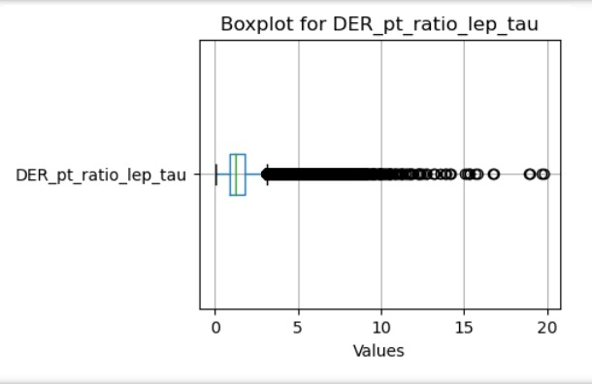
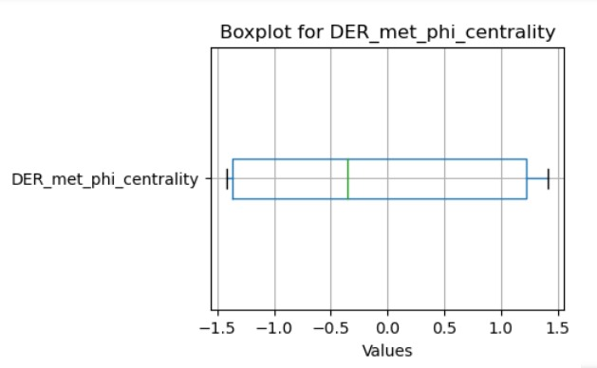
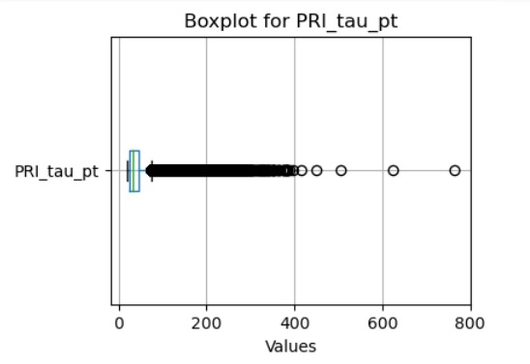
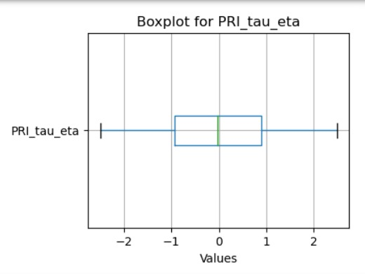
Univariate Analysis (Box Plots)

Slide 24
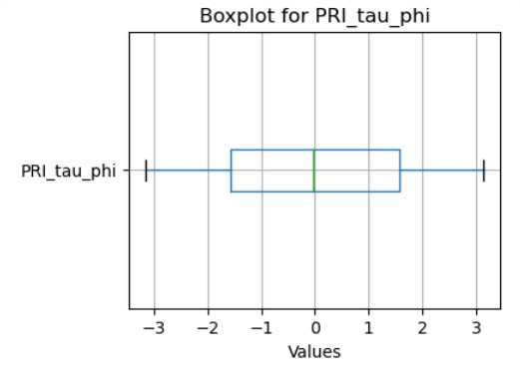
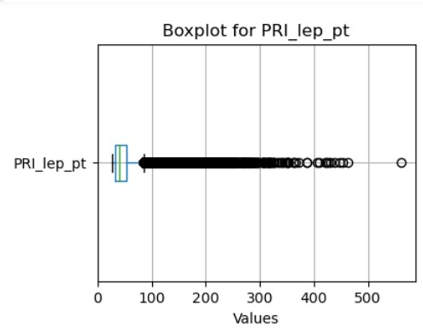
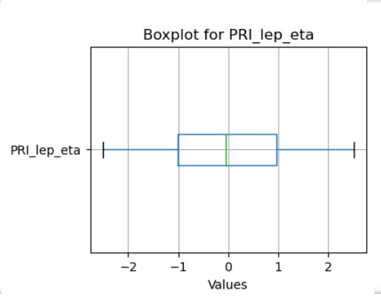
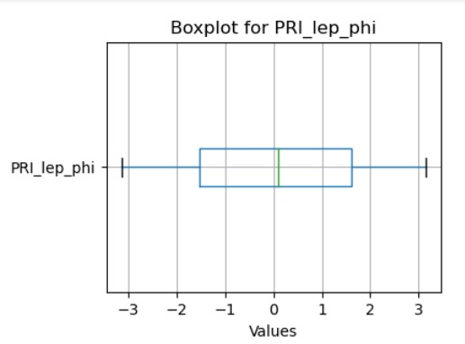
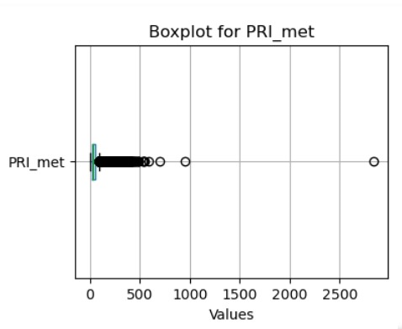
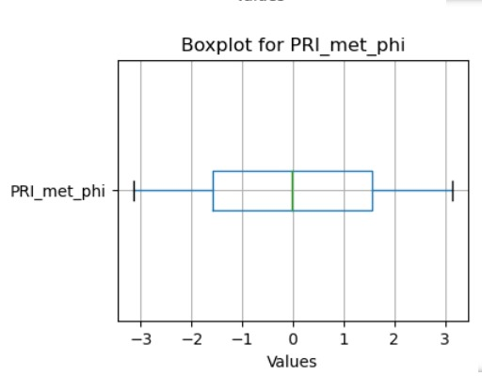
Univariate Analysis (Box Plots)

Slide 25
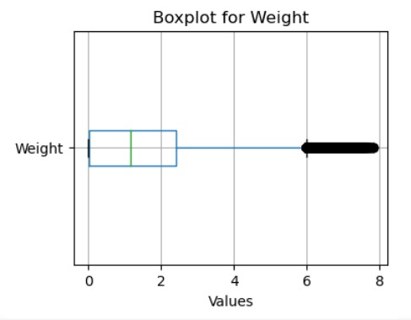
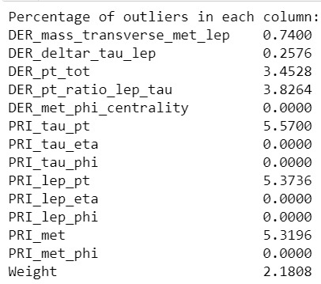
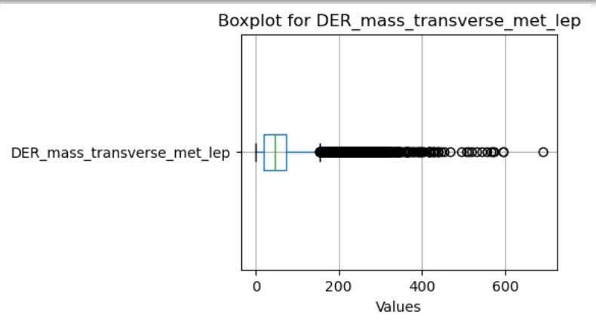
Univariate Analysis (Box Plots)
Percentage of outliers in each column
The Outliers in each column are less than 6% they may be the true measurements/readings, lets keep them as it is

Slide 26
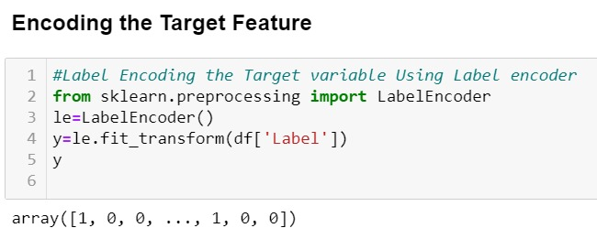
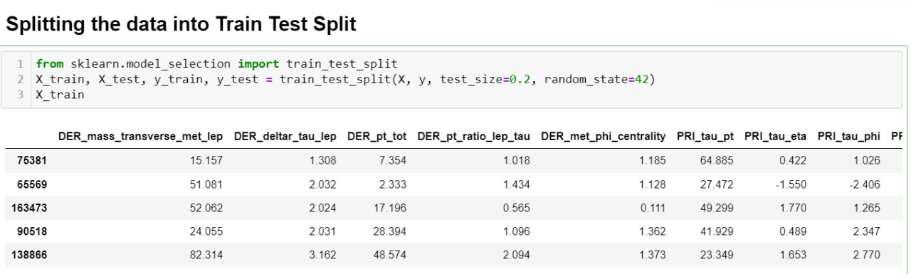
Encoding the Target Feature
By encoding our categorical target variable into numerical values (0 and 1), we make it compatible with a broader range of algorithms.
Train Test Split

Slide 27
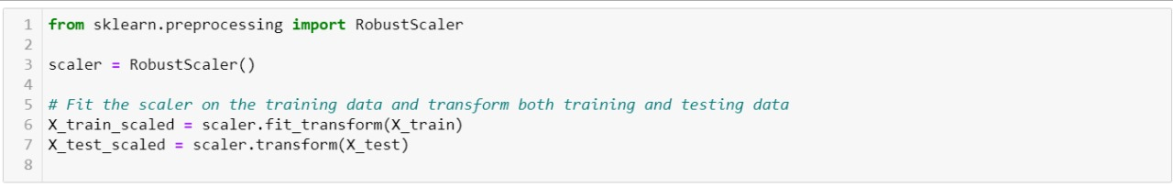
Scaling the Features
When features are on different scales, the algorithm may give more weight to features with larger magnitudes, potentially leading to biased results to avoid this bias we scale the features. Here we have used Robust Scaler as our data has outliers

Slide 28
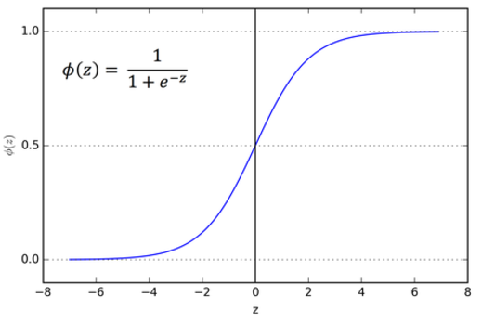
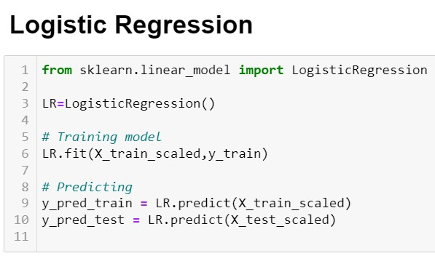
Training the Model with various algorithms
Logistic regression:

Slide 29
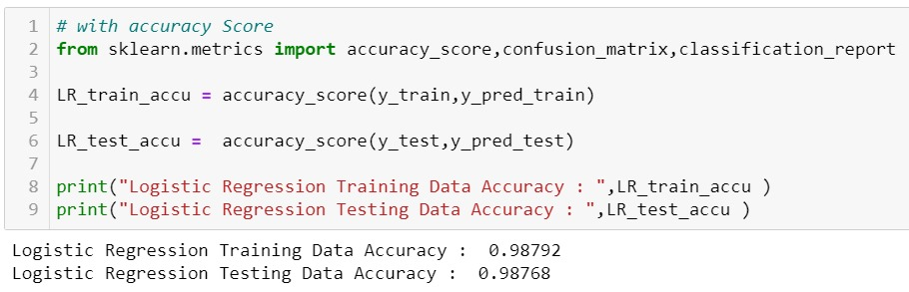
Evaluating the Logistic Regression Model
Accuracy Score:
High Accuracy: The logistic regression model demonstrates high accuracy on both the training and testing datasets, with training accuracy at 98.792% and testing accuracy at 98.768%.
Generalization: The close match between training and testing accuracies suggests that the model is generalizing well to new, unseen data. This is indicative of a well-performing model that is not overfitting to the training data.
Logistic Regression Training Data Accuracy : 0.98792
Logistic Regression Testing Data Accuracy : 0.98768

Slide 30
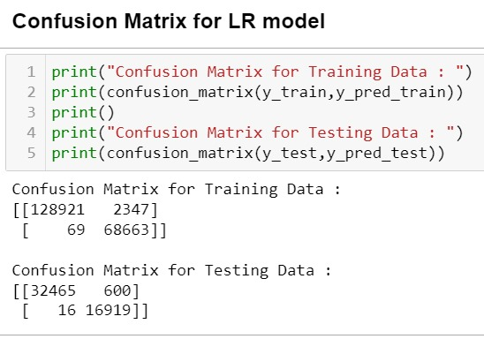
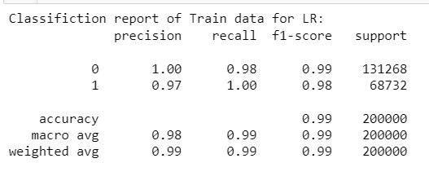
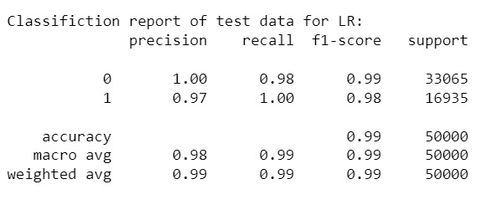
Confusion Matrix
Classification Report

Slide 31
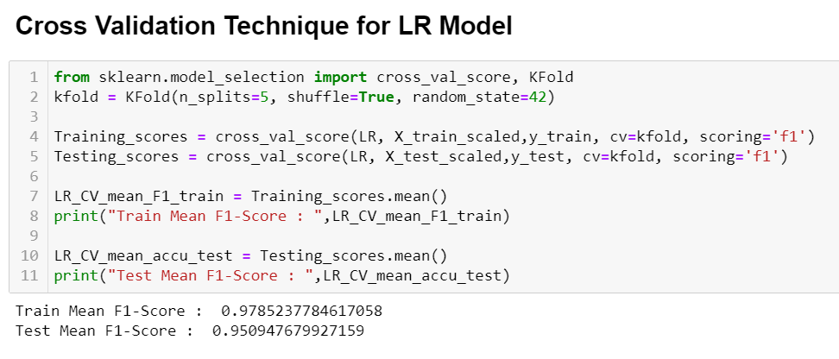
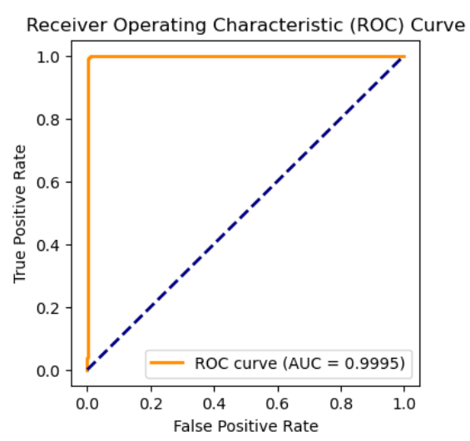
Cross Validation Technique
ROC-AUC Curve

Slide 32
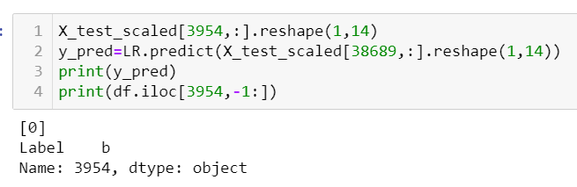
Testing LR Model on Random unseen data

Slide 33
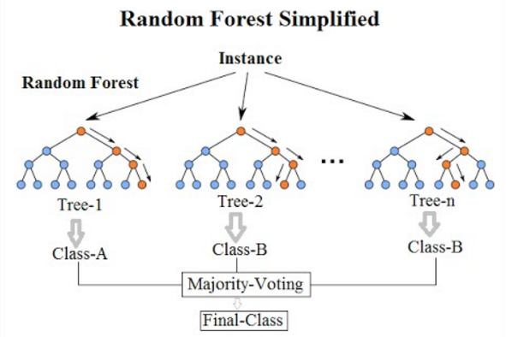
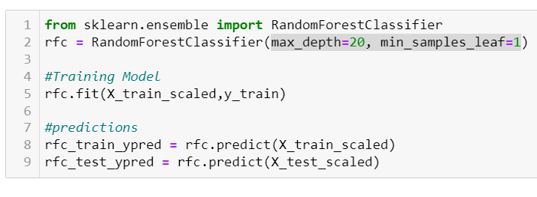
Random Forest Classifier

Slide 34


Evaluating the Random Forest Classifier Model
Accuracy Score:
Confusion Matrix
Random Forest Classifier Training Data Accuracy: 1
Random Forest Classifier Testing Data Accuracy: 1

Slide 35


Evaluating the Random Forest Classifier Model
Classification Report
ROC-AUC Curve

Slide 36


Evaluating the Random Forest Classifier Model
Cross Validation Technique
Cross Validation on Hold out Set
Cross Validation mean F1 Score: 1.0
Holdout Set F1 Score: 1.0

Slide 37


Model Selection

Slide 38
Conclusion
Model Selection
Random Forest Classifier: Best choice if computational cost is not a concern. It offers high accuracy and robustness to data imbalance and overfitting.
Logistic Regression: Preferred when computational efficiency and interpretability are crucial

Slide 39


Conclusion
Refining Classification Models
Hyperparameter Tuning: Optimize model performance, specifically for the Random Forest model.
Ensemble Methods: Explore AdaBoost, Gradient Boosting, or XGBoost to leverage their combined strengths for superior predictive performance.
Deep Learning: Experiment with neural network architectures to capture complex relationships in the data.

